Slide 1
ESQC 2024
Mathematical Methods Lecture 4
By Simen Kvaal

Slide 2

Where to find the material
SCAN ME
Alternative 1:
www.esqc.org, go to“lectures”
Find links there
Alternative 2:
Scan QR code
simenkva.github.io/esqc_material

Slide 3
Vector calculus
Functions, integration and differentiation, in one and several variables

Slide 4


Functions of several variables
I am a vector valued function!
We turn to the study of vector valued functions
Such as paths ... scalar-valued functions

Slide 5
Compared to yesterday ...
We studied Banach spaces of functions:
Metric measured distance between functions
Now, we study the function itself:
Now the metric measures distance in Euclidean space

Slide 6
In quantum chemistry
Hartree-Fock, for example
Most methods can be formulated as:

Slide 7
A typical domain Ω
Boxes in n dimensions
The theory handles very general shapes
Intervals are typical

Slide 8
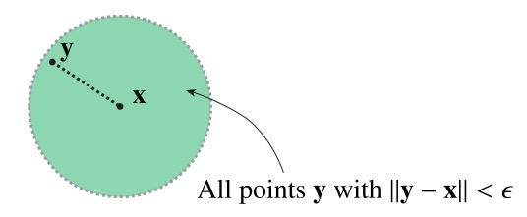
Topology of Euclidean space
Definition of an epsilon-ball

Slide 10
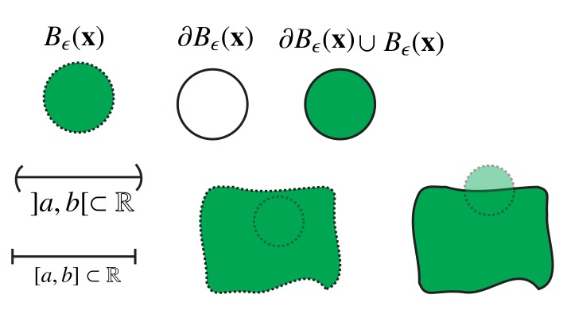
Examples

Slide 11
Neighborhood of x
Any set containing x and an open ball around x

Slide 13
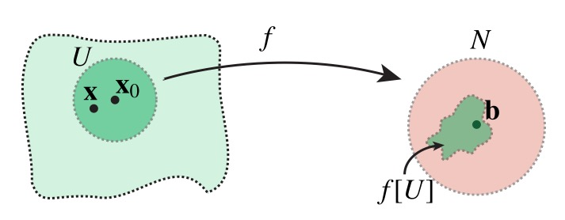
Intiuition

Slide 14
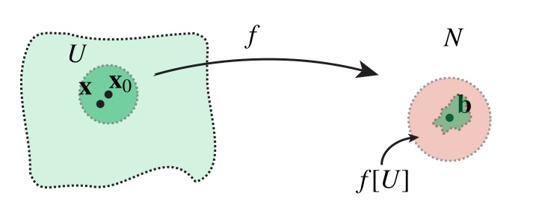
Intiuition

Slide 15
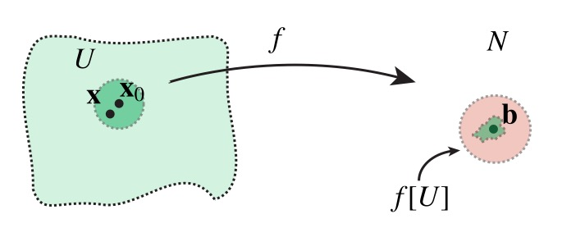
Intiuition

Slide 16
Multidimensional version of “unbroken graph”

Slide 17
Discontinuous in 1d

Slide 18
Discontinuous in 1d
However we choose U, it will betorn apart by f

Slide 19
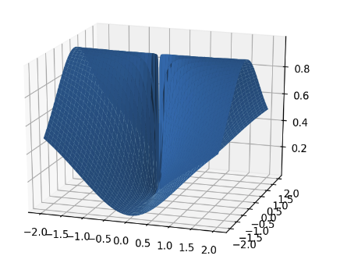
Example
Is the following function continuous at (0,0)?
No, because the limit does not exist.
Different limit candidates if we approach from different directions
The definition of limit is designed to detect such situations

Slide 20
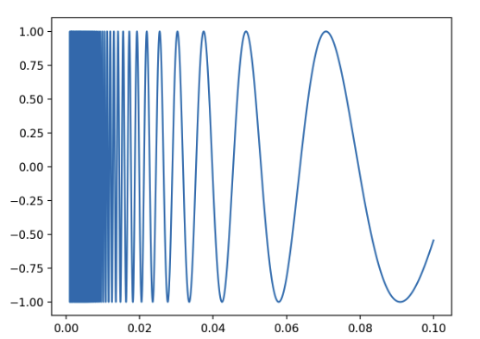
More subtle, in 1D
Is the following function continuous?
Yes, since we do not include 0 in the domain
But f has no limit at x = 0

Slide 22
These two theorems can be used to decide continuity of very complicated functions, once simpler functions are proven to be continuous

Slide 23
Examples
polynomials in any variable
exponential function
sine, cosine …
any composition of such
careful with division!

Slide 25
Example

Slide 26
Single-variable functions
For ”ordinary” functions f : [a,b] ⊂ℝ → ℝ, consider the derivative: if the limit exists.
Indeed, for vector-valued functions, the partial derivative is calculated as if f was a1-variable function!
All the other variables are "held constant"

Slide 27
Derivative as slope
Derivative is the slope of tangent at x
When f(x) has a derivative at x, the function can be approximated
Here y is close to x
Want something like this for vector-valued funcs

Slide 28
Derivative as slope/tangent
Partial derivative is the rate of change as one moves in one direction

Slide 29
Existence of partial derivatives seems good …

Slide 30
Existence of partial derivatives seems good …
Existence of partial derivatives at a point is NOT GOOD ENOUGH!

Slide 31
What does this mean?

Slide 32
Interpretation of diffability condition
Small error term
Condition for a first-order Taylor polynomial at x₀
Generalization of the slope of the tangent line to higher dimensions

Slide 33

Intuitive, and good to know
Resolves the ugly example

Slide 34
Continuously differentiable functions
These functions can always be approximated by first-order Polynomials

Slide 35
Linearity
Linearity
Product rule
Quotient rule

Slide 36


Slide 37
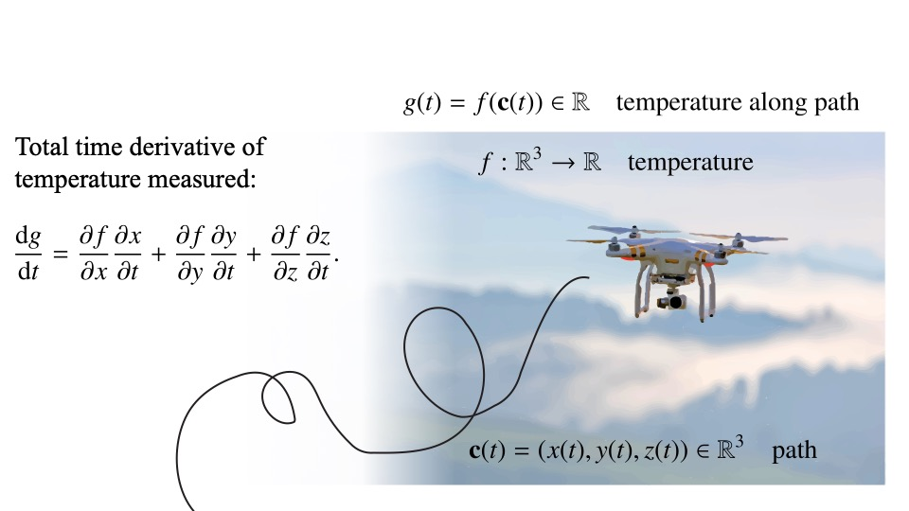
Ex: Drone measuring temperature

Slide 38
Higher derivatives
f is of class C² if the partial derivatives (matrix elements of Df) are of class C¹
Matrix elements of D(Df) = D²f: Iterated partial derivatives
Fact: If C², then partial derivatives are symmetric

Slide 39

Important for optimization!
Polynomial!

Slide 42
Local extrema
Let be twice differentiable, and
Local maximum:
Local minimum:
Fact: Any local extremum is a critical point:

Slide 43
Critical points
A critical point can be a local minimum, maximum, or saddle point
Saddle points are critical points that are not a max/min

Slide 44
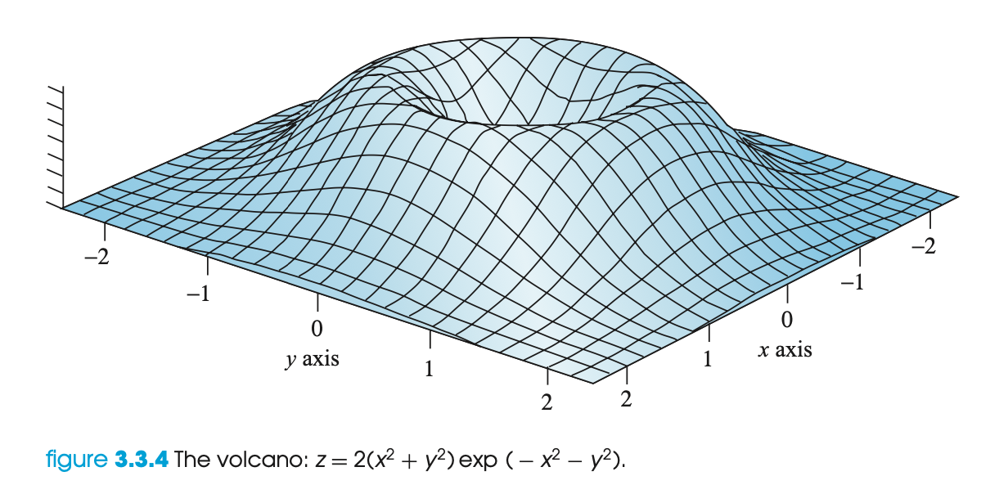
Example: The volcano function
Local max at the rim
Local min in the well
Picture from Marsden and Tromba, ”Vector Calculus”

Slide 46
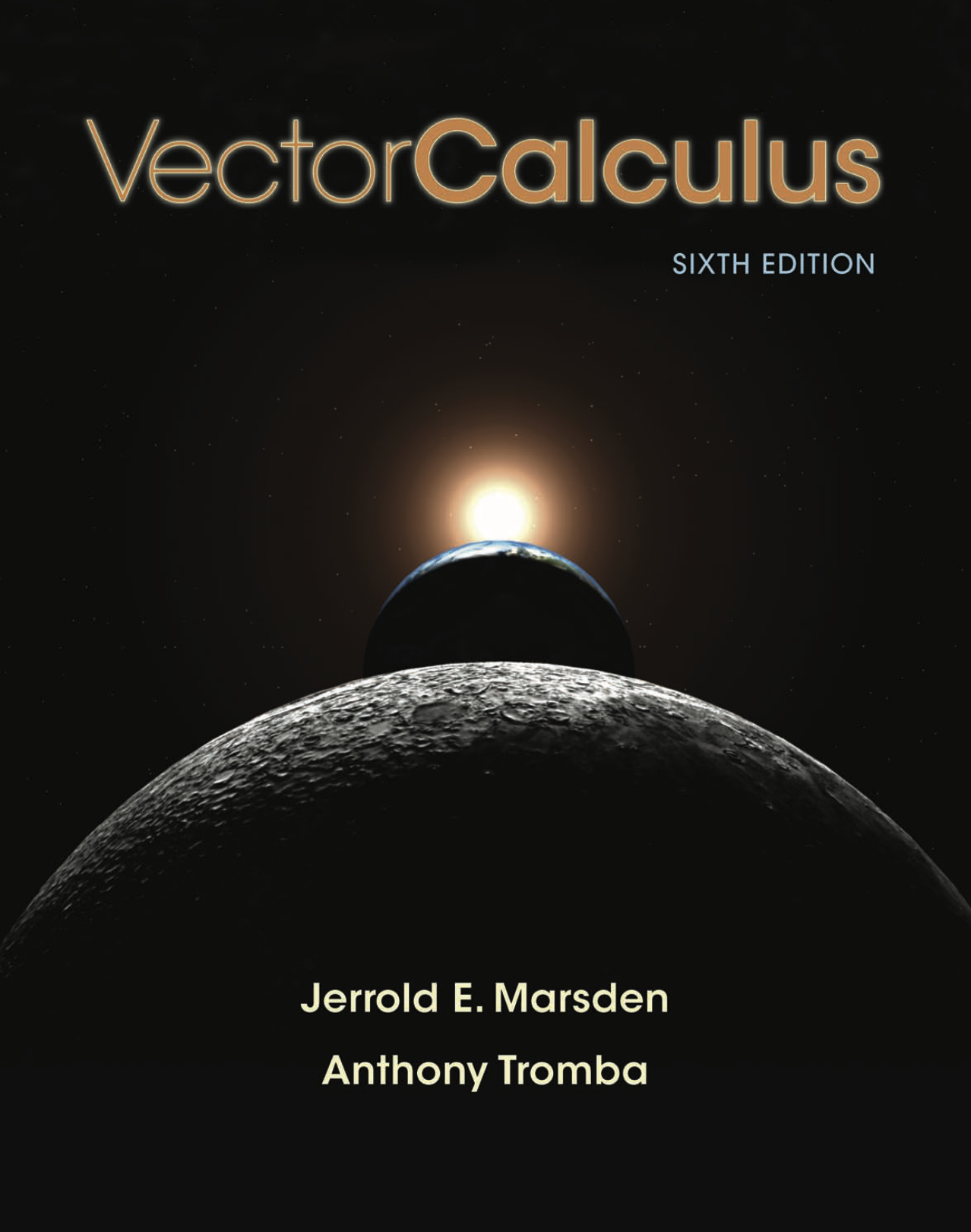
Further topics
Series and convergece of series
Integration over curves, surfaces, volumes ...
Vector operations: curl, divergence, gradient ...
Gauss’ and Stoke’s theorems for integration
My presentation is based on →

